Slide 1


Slide 2
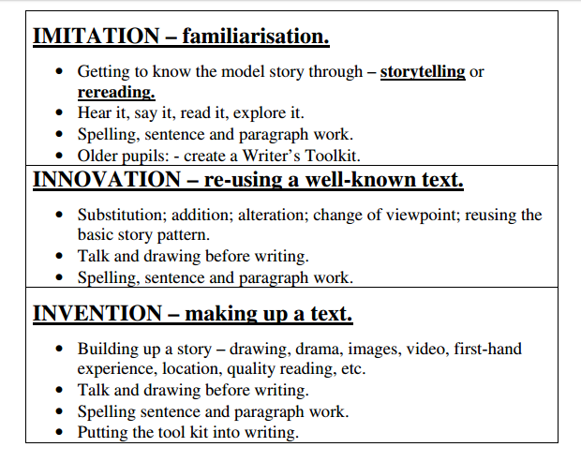

Slide 3

How to encourage better writing?
Writing sentences every day even if shared. Ideally children doing this in pairs and then on their own. Children need to get used to rapidly constructing sentences. This has a big impact on confidence. Phonics in those ‘tiny’ in between times we get! Keep sessions speedy. (list of sentence/word games)
Writers toolkits (Boxing up)- what makes a great sentence, narrative, poem. Based on reading of good texts. Share write a toolkit together until ready to do on own. (handout)
Comparing good with not so good. Eg. We had this sentence eg. ‘The man saw the bird’
Now we have this ‘The policeman stared at the golden eagle’. Which is best and why?
Overwriting – welcome aspect of young writers development.
Kung Fu punctuation (handout)
Teacher modelling writer talk is essential- thinking out loud, improving, changing mistakes.

Slide 4



Star challenges in our success criteria. Make them more visual, refer to them. Rewards for them.

Slide 5

Shared writing:
- Talk out loud about how you are writing
- Magpie words - Use TA to do this during shared writing.
- Magpie words during story time. Get the children to choose a word they want to magpie and write it in the magpie and put on display. Be the model, don’t accept the first answer keep pushing or suggesting.
-Model re-reading and editing. https://www.youtube.com/watch?v=LGMv6Tf-Lm4&app=desktop Pie Corbett Shared write

Slide 6
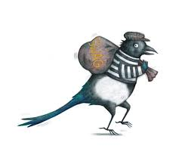
Swag book
Used to magpie books, draw their own story maps for books they are reading. Copy sentences, words they like. Draw, write and generally generate ideas. Show real life writers journals.

Slide 7
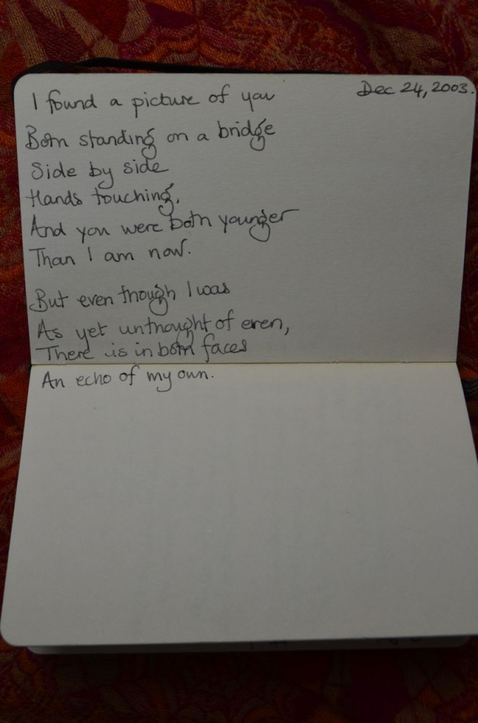
Jackie Morris – write and artists journal

Slide 8

Greater Depth
- Seeing every lesson as an English lesson.
- Planning longer sequences that allow children to get to know a book inside out.
- When reading, pointing out how writers use language and words for impact and ‘magpie’.
- Teaching grammar explicitly and in context. Playing with language (Rainbow Grammar)
- When reading asking children to listen out for grammar, words they want to magpie. Writing a sentence on the board and getting children to guess punctuation. Being ‘stuck’ on a word so that children blend for you and link their phonics to the real world.
- Sharpen learning objectives eg. ‘I can carefully select adjectives’ rather then ‘I can use adjectives.’
- Saying a word might not be effective pushing for more (as discussed)
- Less emphasis on covering so many text types in each year group. Imbedding, teaching one type in greater depth. (eg. Year one- re telling, recounting, non-fiction fact)
-Re thinking differentiation, using scaffolding to support children with the same objective.
-toolkits for writing, unpicking what it is you need for a sentence or text type.
-Don’t move on too quickly- embed!
-Culture of challenge

Slide 9

Feedback and Marking
-Hidden feedback – what you are doing all the time but don’t even realise. Record hidden feedback when observing. Eg. The look a teacher gives a child, the tap on the page, the verbal reminder, asking children to read it back, check etc.
- Don’t give too much praise. Use it sparingly so that it is meaningful.
-Monitor what you have asked before.
-No Reason we can’t write ‘very good’ ‘beautiful’ as it can have an impact on the child- confidence. Only if it is!
-Marking/feedback should be used to further children’s learning not prove what we are doing.
-Why mark for children who can’t read?
-Take more time to observe children. Stand back!
-Don’t waste time explaining written marking to children. Just tell them!

Slide 10
Finally….
‘Do less but better.’
‘Assess more, record less.’
‘Don’t teach to the test, test what you teach.’
‘A test is a snapshot, remember we are here to make a difference.’

Slide 11
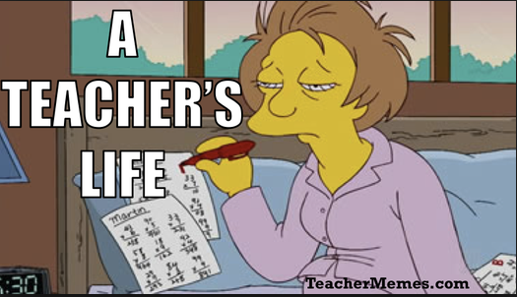
You laugh, you cry and you work harder than you ever thought you could. Some days your trying to change the world and some days your just trying to make it through the day. Your wallet is empty, your heart is full. Your mind is packed full of memories of children who have changed your life (for better or worse) but also of children whose lives you have changed.
Just another day in the classroom.

